Slide 1
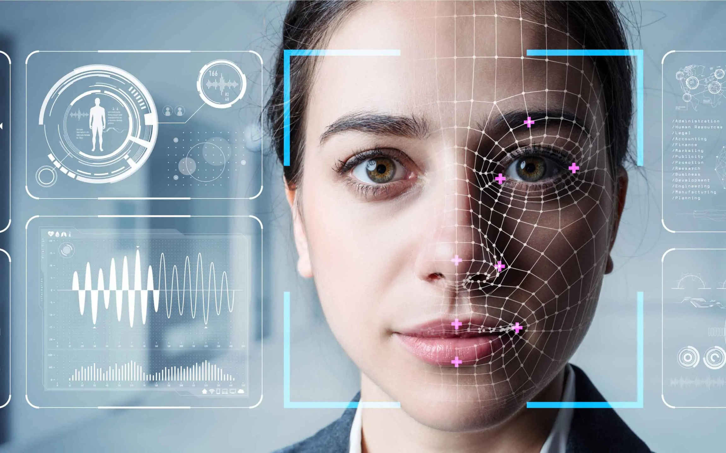


By
TECH
WARRIORS

Slide 2


Problem Statement
To Design and Develop a Deep Learning algorithm to classify the video as deepfake....

Slide 3





















Introduction
06
Training Workflow
01
System Architecture
07
Prediction Workflow
02
Tools and Technologies
03
Dataset Exploration
08
Pre-processing
09
Results
04
Model Architecture
10
Demo
05

Slide 4

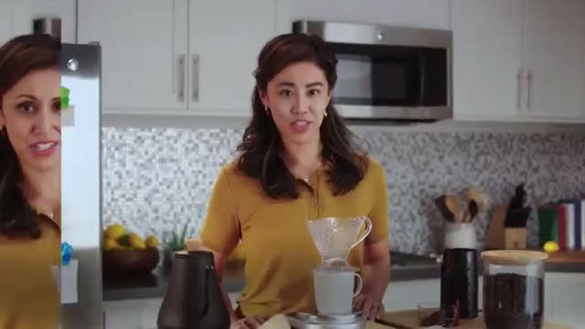




Introduction
Deepfake is an artificial intelligence-driven method used to create synthetic images of humans.
Deepfakes are generated through the application of a deep learning methodology called generative adversarial network (GAN), wherein existing images and videos are merged and overlaid onto source images or videos.

Slide 5


Can we detect Deep fakes
with naked eyes?

Slide 6
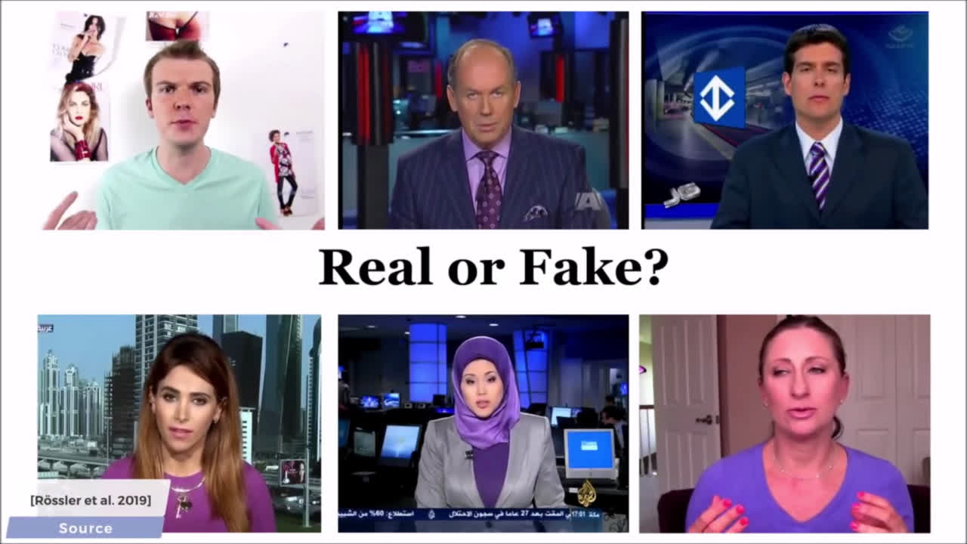

Slide 7
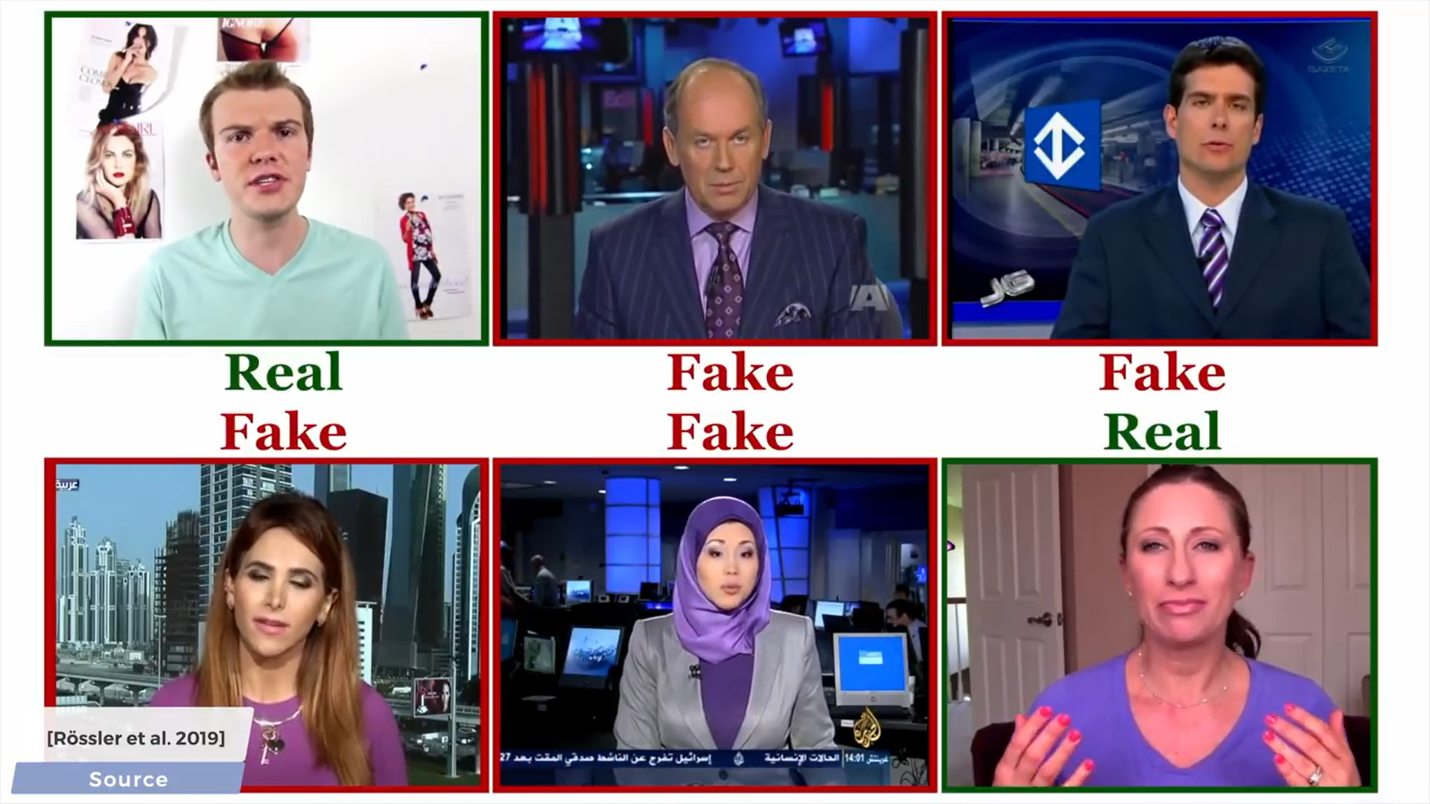

Slide 8


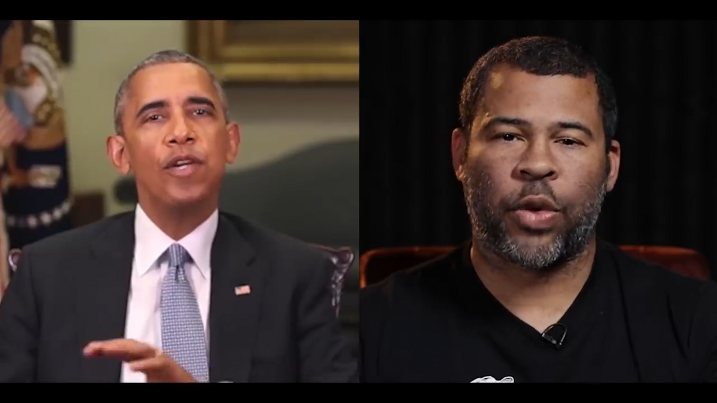
Why Deep Fake Detection?
Fake News
Malicious hoaxes
Financial fraud
Celebrity unusual video
Revenge porn
Politician videos

Slide 9
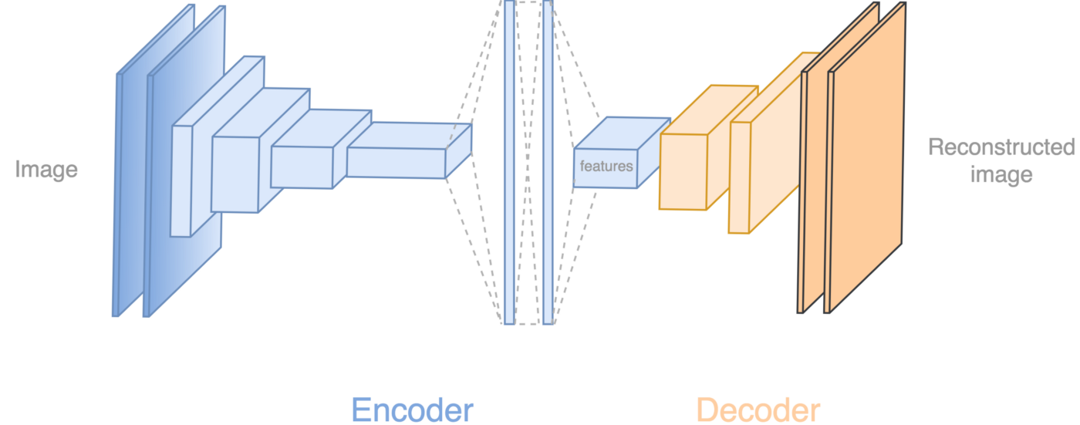
How Deep Fakes Are Created ?
Tools for deep fake creation.
1)Faceswap 2)Faceit 3)DeepFaceLab 4)DeepfakeCapsuleGAN 5)Reface

Slide 10
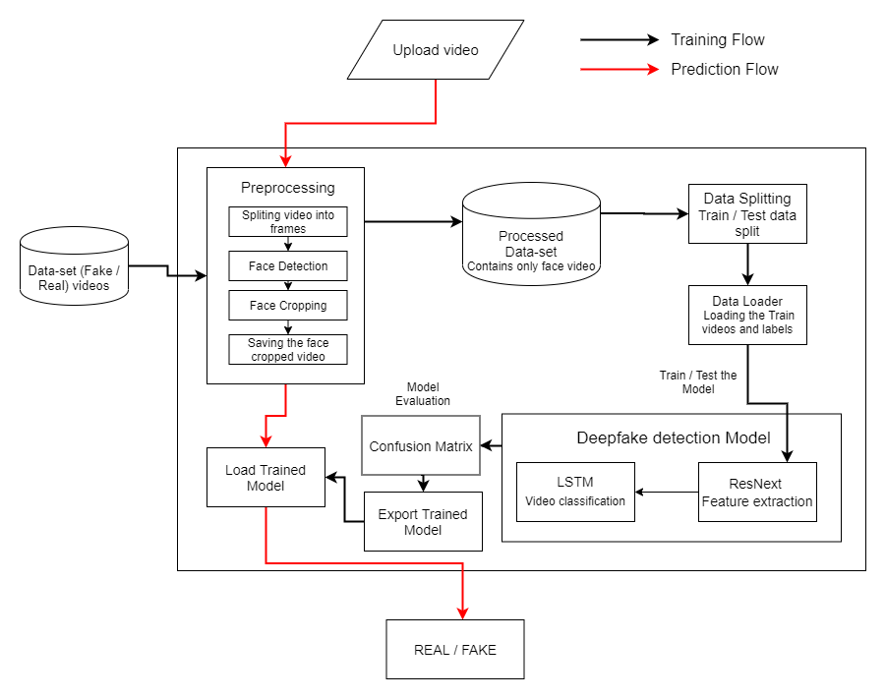
System Architecture

Slide 11
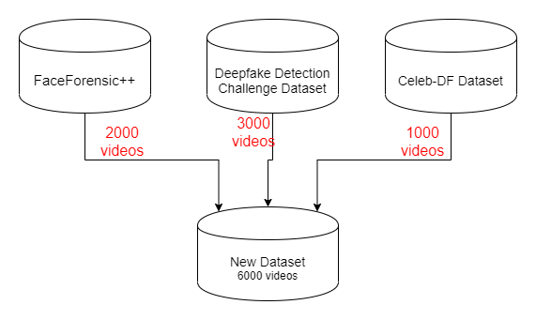
DATA-SET
EXPLORATION

Slide 12

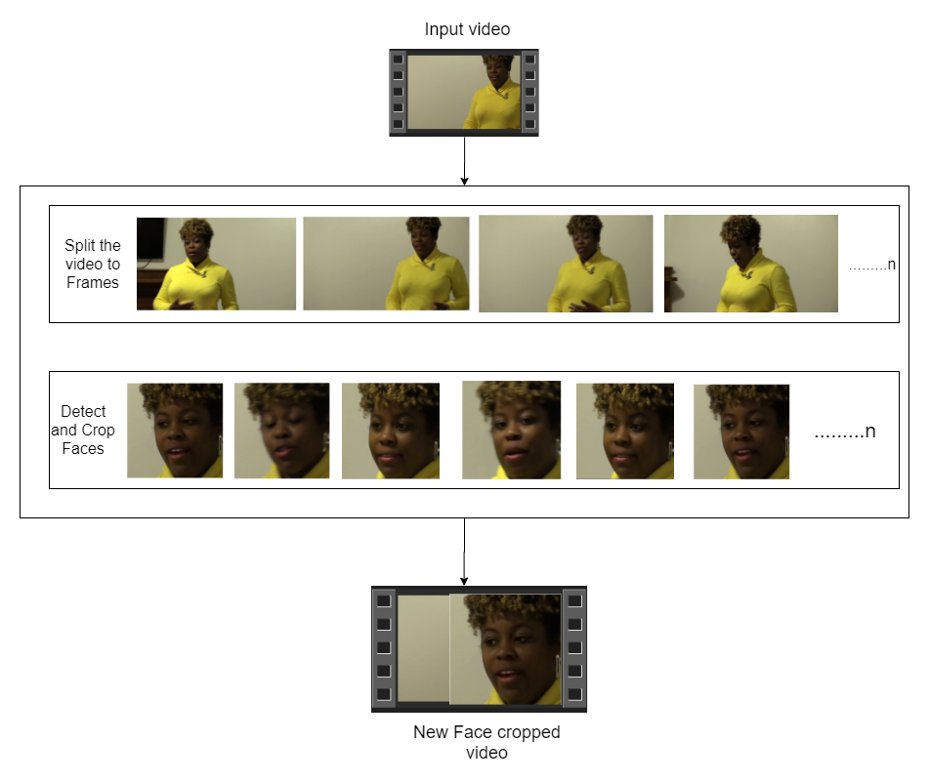

1
SPLIT VIDEO INTO FRAMES
PRE
2
FACE DETECTION
PROCESSING
3
CROPING FACE
4
CREATING NEW FACE CROPPED VIDEO
5
SAVING THE FACE CROPPED VIDEO

Slide 13



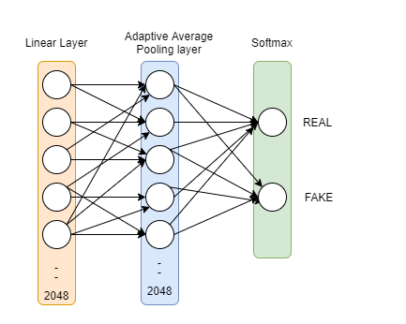
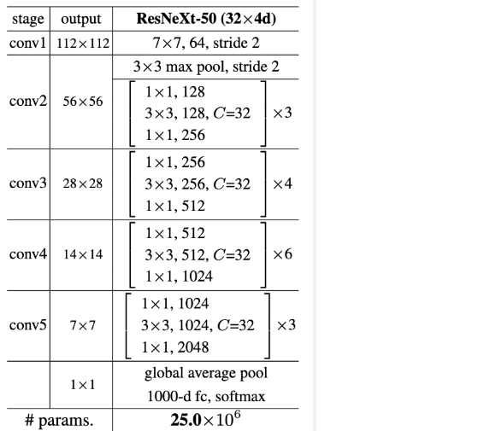
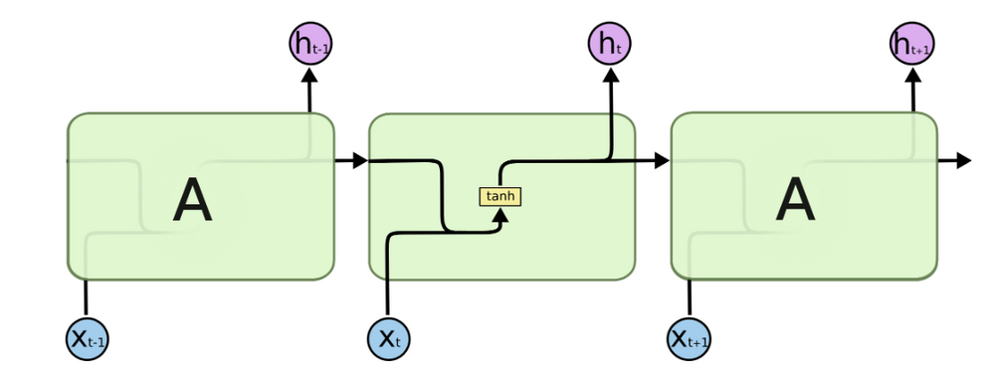
Model Architecture
ResNext-50
1 LSTM layer with 2048 shape input vector and 2048 latent features along with 0.4
chance of dropout and ReLU Activation function
Sequential Layer

Slide 14
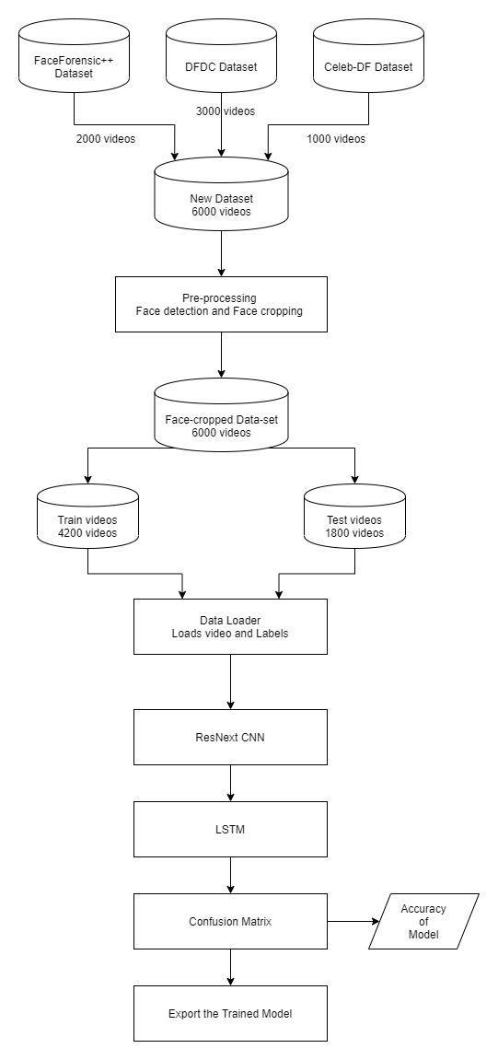
Training Workflow

Slide 15
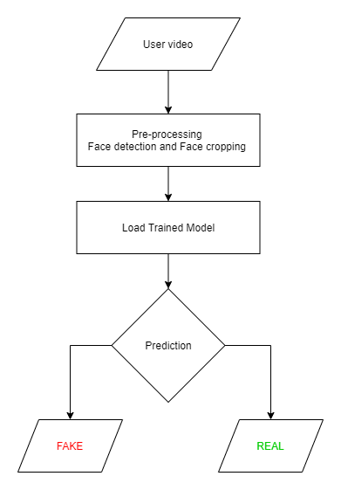
Prediction Workflow

Slide 16













Programming Languages
Python3
Programming Frameworks
PyTorch
Django
Tools and Technologies
IDE
Google
Visual Studio Code
NVIDIA GPU
Version Control
Git

Slide 17

Model Name | Dataset | No of Videos | Sequence Length | Accuracy
model_90_acc_20_frames_FF_data | FaceForensic++ | 2000 | 20 | 90.95477387
model_95_acc_40_frames_FF_data | FaceForensic++ | 2000 | 40 | 95.22613065
model_97_acc_60_frames_FF_data | FaceForensic++ | 2000 | 60 | 97.48743719
model_97_acc_80_frames_FF_data | FaceForensic++ | 2000 | 80 | 97.73366834
model_97_acc_100_frames_FF_data | FaceForensic++ | 2000 | 100 | 97.76180905
model_84_acc_10_frames_final_data | Our Dataset | 6000 | 10 | 84. 662519
model_87_acc_20_frames_final_data | Our Dataset | 6000 | 20 | 87.79160186
model_89_acc_40_frames_final_data | Our Dataset | 6000 | 40 | 89.3468118195956
model_91_acc_60_frames_final_data | Our Dataset | 6000 | 60 | 91.5909797822706
model_92_acc_80_frames_final_data | Our Dataset | 6000 | 80 | 92.4981855883877
model_93_acc_100_frames_final_data | Our Dataset | 6000 | 100 | 92.10883877
R
E
S
U
L
T
S

Slide 18


Slide 19




